Slide 1
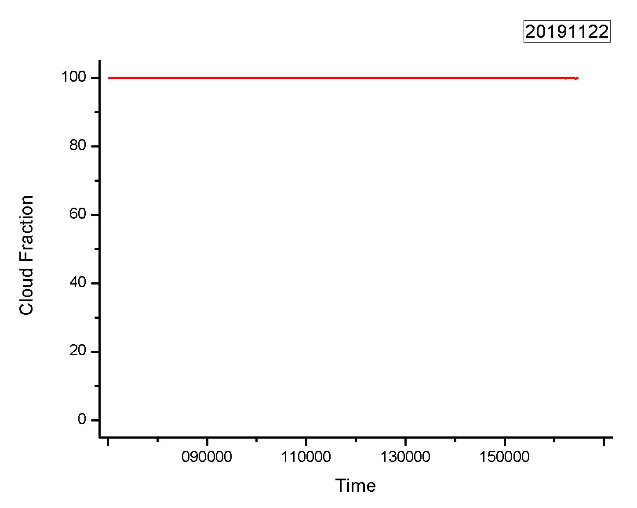
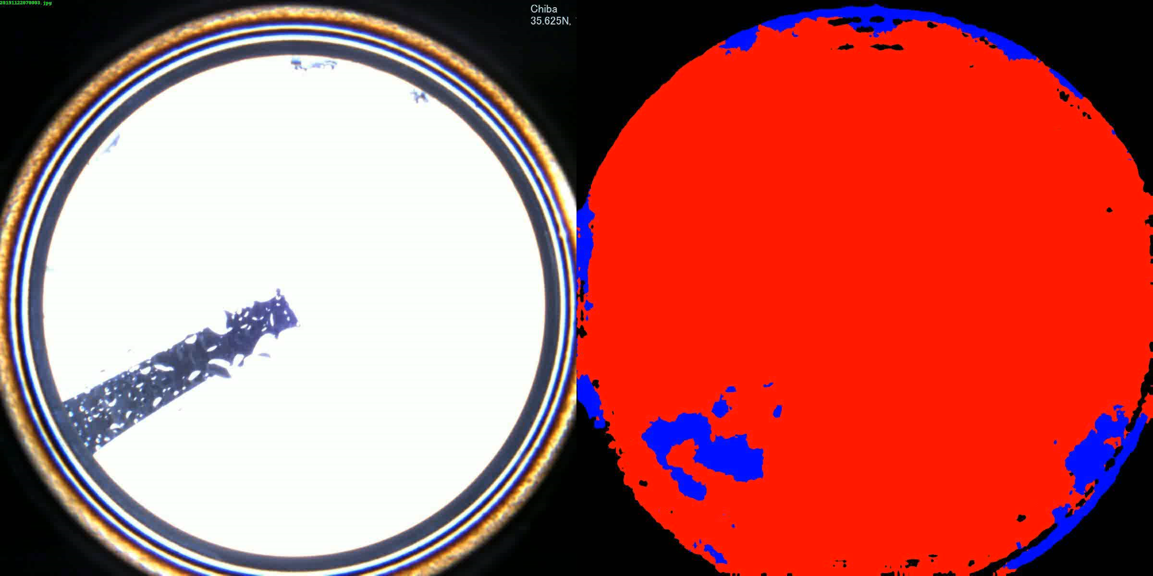
Cloud Fraction
2019.11.22
Skyview images and their segmentation
Cloud fraction

